Slide 1

Rockbuster Stealth
Data Analysis for 2020 Strategy
Sruthy Sreekanth

Slide 2
Agenda
Overview
Analysis
Summary & Recommendations
Conclusion

Slide 3
Overview
Rockbuster Stealth LLC is a movie rental company that used to have stores around the world.
The Rockbuster Stealth management team plans to use its existing movie licenses to launch an online video rental service in order to remain competitive in the face of fierce competition from streaming services like Netflix and Amazon Prime.
In order to drive their 2020 company strategy, the Rockbuster Stealth Management Board has posed a number of business questions and expects data-driven responses.

Slide 4
The following analysis was carried out on a sample of the data provided for this project.
Analysis
Countries
Generate the most Revenue
With the most customers
Customers
Location with high lifetime value customers
Revenue
By Genre
By Rating
Rental Duration
By Genre
By Rating
Top cities within top countries
By Movies

Slide 5
Countries
Generate the most Revenue
With the most customers
Customers
Location with high lifetime value customers
Revenue
By Genre
By Rating
Rental Duration
By Genre
By Rating
Top cities within top countries
By Movies

Slide 6
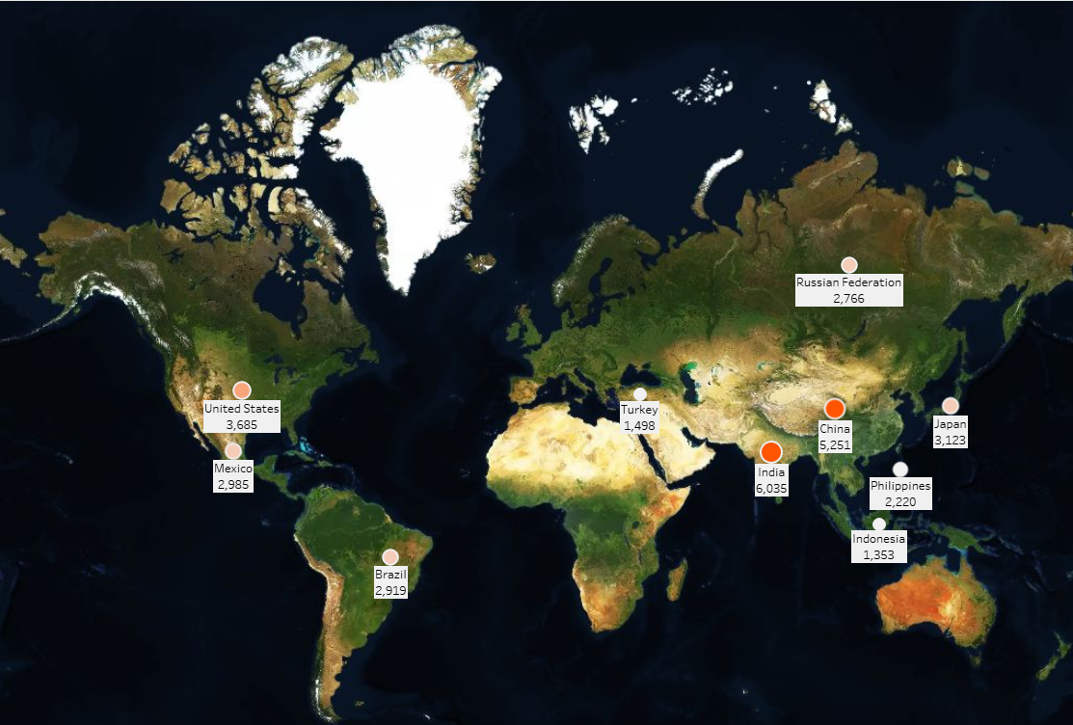
Which Countries generate the most Revenue?
India and China are the two countries that generate the most revenue.

Slide 7
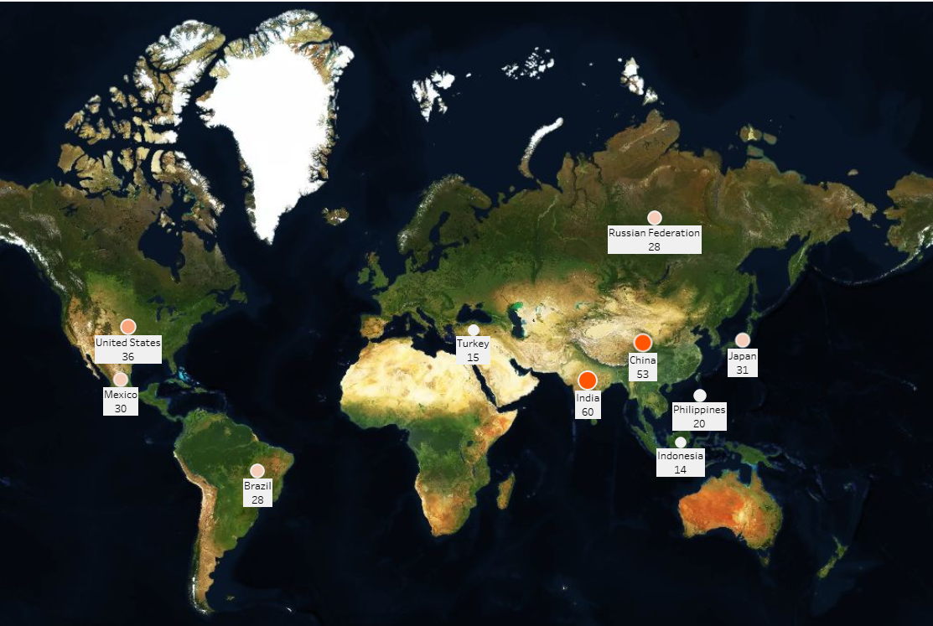
What are the top countries with the most customers?
Rockbuster has locations in 109 countries.
This map lists the top 10 countries where Rockbuster should focus on promoting its online renting services.
India should receive the most marketing since it has the largest customer base.

Slide 8
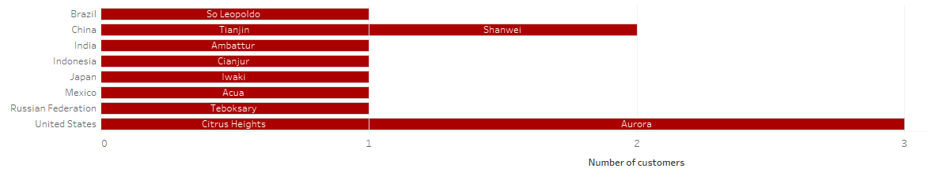
What are the top cities located in the top countries with the most customers?
The city with the most customers is Aurora, which is in the United States.
Rockbuster should aim its marketing at Aurora.

Slide 9
Countries
Generate the most Revenue
With the most customers
Customers
Location with high lifetime value customers
Revenue
By Genre
By Rating
Rental Duration
By Genre
By Rating
Top cities within top countries
By Movies

Slide 10
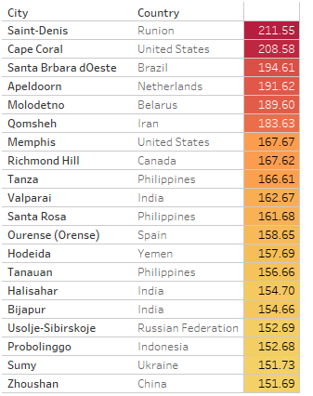
Where are customers with high lifetime value based?
Rockbusters' highest-spending customer resides in Saint-Denis, Réunion
India and the Philippines have the most customers among the top 20 with three each.

Slide 11
Countries
Generate the most Revenue
With the most customers
Customers
Location with high lifetime value customers
Revenue
By Genre
By Rating
Rental Duration
By Genre
By Rating
Top cities within top countries
By Movies

Slide 12
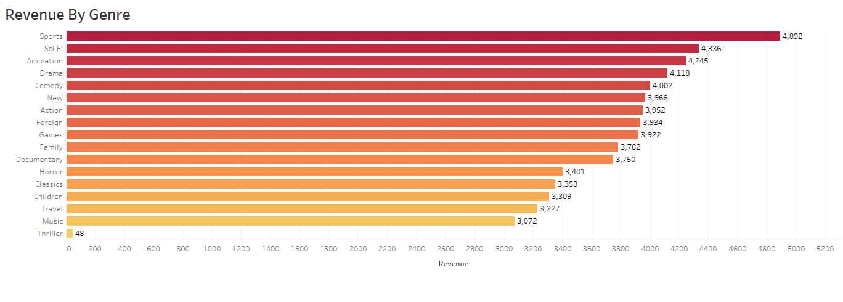
Which of Rockbuster’s Genres are most profitable?
Sports is the category with the highest revenue at $4,892.
The least popular category, thriller, brought in $48.

Slide 13
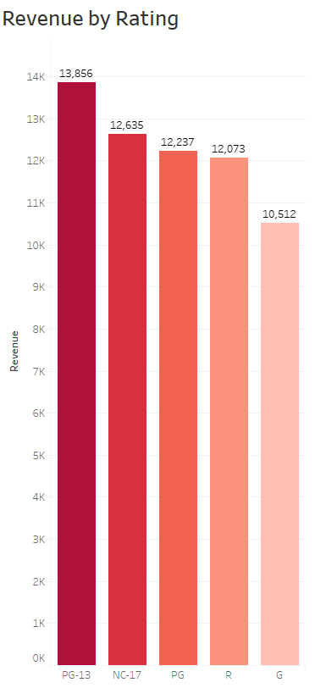
Which of Rockbuster’s Ratings are most profitable?
The most profitable classification for Rockbuster is PG-13, which also has the highest revenue of all the ratings
The least profitable rating is G. This might be an indication that kids' movies aren't as popular as others, based on other ratings.

Slide 14
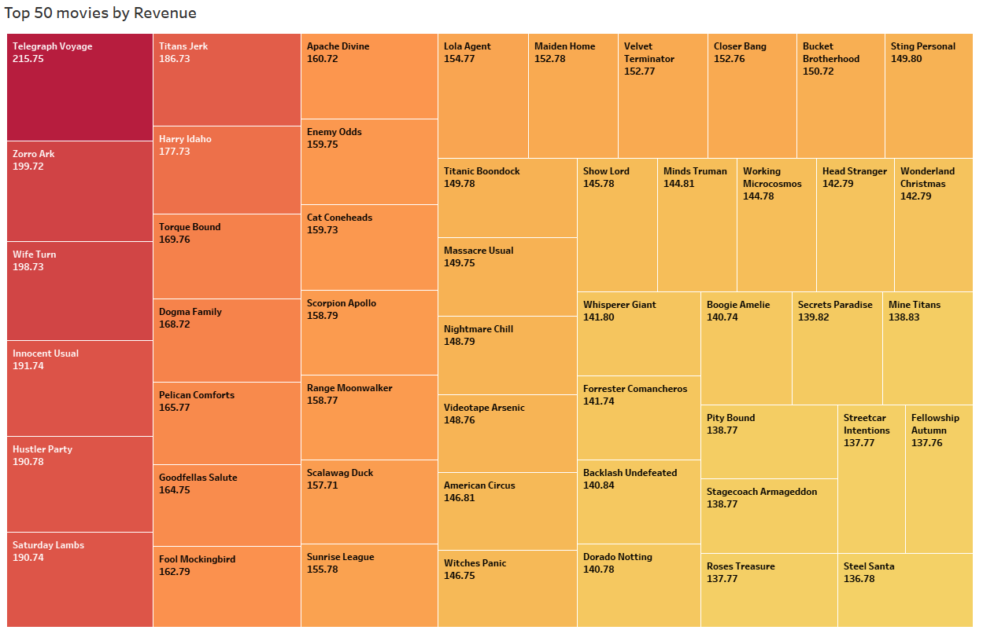
Which movies contributed the most to revenue gain?
The most popular film, earning $215.75, was Telegraph Voyage.

Slide 15
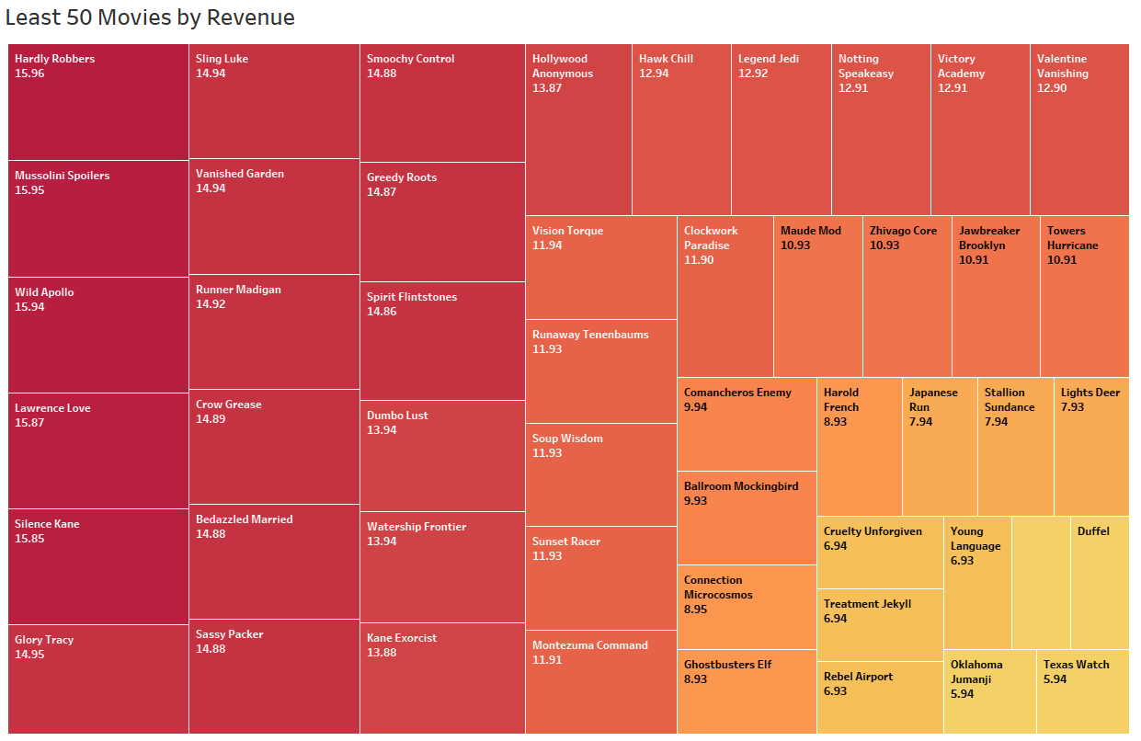
Which movies contributed the least to revenue gain?
Texas Watch, which earned $5.94, was the movie with the lowest revenue.

Slide 16
Countries
Generate the most Revenue
With the most customers
Customers
Location with high lifetime value customers
Revenue
By Genre
By Rating
Rental Duration
By Genre
By Rating
Top cities within top countries
By Movies

Slide 17
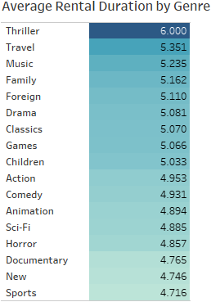
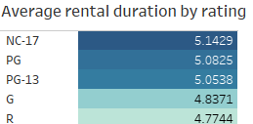
what was the average rental duration for all videos?
The average duration of a Rockbuster rental is 4-6 days, with Thriller (genre) and NC-17 (rating) having the highest averages.

Slide 18
Summary & Recommendations
The majority of Rockbuster's customers are from Asia, with India and China having the greatest numbers of customers. Therefore, these regions should be the focus of marketing activities.
Additionally, Rockbuster needs to focus its customized marketing and promotions in regions with high customer lifetime value.
Movies about sports, sci-fi, and animation have the largest revenue shares, followed by dramas and comedies. This data can be used to guide Rockbuster's decision regarding which movies to provide on their new online video service.
All videos have an average rental period of five days, which can be used to determine customer pricing and rental period preferences.

Slide 19
Conclusion
According to the analysis, Rockbuster Stealth should focus on promoting profitable movie titles and direct marketing campaigns toward the regions with the highest customer numbers and lifetime values, primarily Asia with content focused on sports, sci-fi, and animation films.

Slide 20
Thank You
Visualization link:
Rockbuster stealth-data analysis | Tableau Public

